Slide 1


Live Stock Monitoring System
IoT and Machine Learning-based Anomaly Detection

Slide 2


Title
Why is livestock monitoring important?
Motivation
Proposed Solution
Future Enhancements
Conclusion

Slide 3
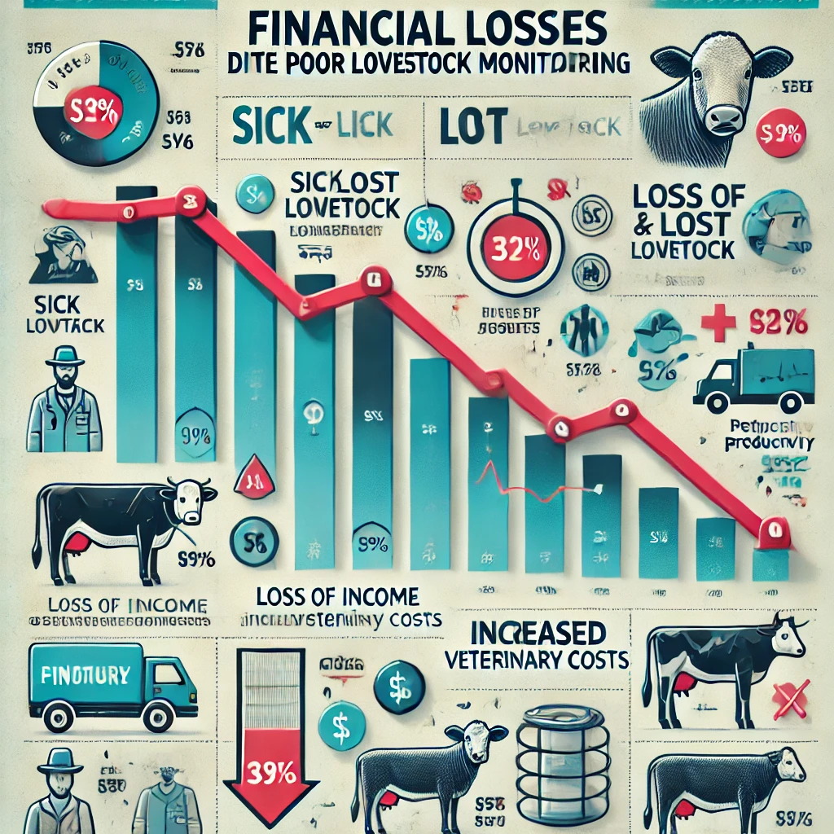
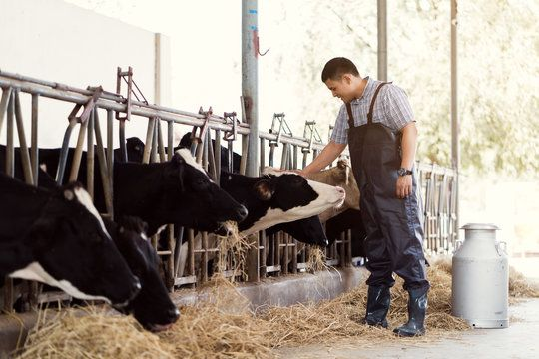
Why is livestock monitoring important?
Challenges in Traditional Livestock Monitoring:
High livestock losses due to delayed health issue detection.
Manual monitoring is labor-intensive & costly.
Existing automated solutions are expensive

Slide 4
Motivation
Why automate livestock monitoring?
Reduce livestock loss due to diseases or theft.
Early anomaly detection for animal movement/health issues.
IoT & ML make monitoring efficient, scalable & real-time.
Existing solutions are too expensive for farmers. Many small-scale farmers cannot afford these systems.

Slide 5
Proposed Solution
How Our System is Cost-Effective?
Hardware Optimization → ESP8266 (NodeMCU) instead of Raspberry Pi (Cheaper but powerful).
Efficient Data Storage → Google Sheets API (Free) instead of costly cloud services like AWS.
Affordable Sensors → MPU6050 & NeoM8M GPS provide necessary data at a low cost.
Open-source Machine Learning (TensorFlow, Keras) → Avoids paid AI models.
Optimized Power Usage → Solar Powered Batteries
Removes the need for frequent battery replacement.
Reduces long-term operational costs.
Makes the system more-sustainable & eco-friendly.

Slide 6
Hardware Components Used
Key Hardware Components:
NodeMCU ESP8266: Microcontroller for data transmission.
MPU6050: Accelerometer & Gyroscope for motion tracking.
NeoM8M GPS Module: Location tracking.

Slide 7
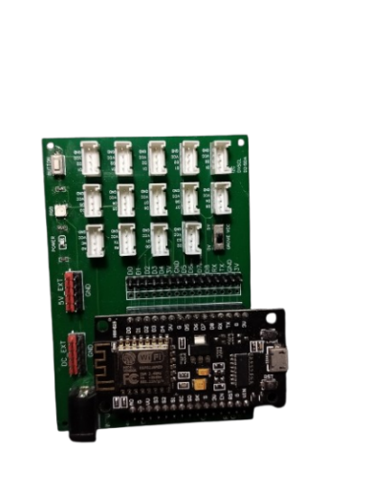
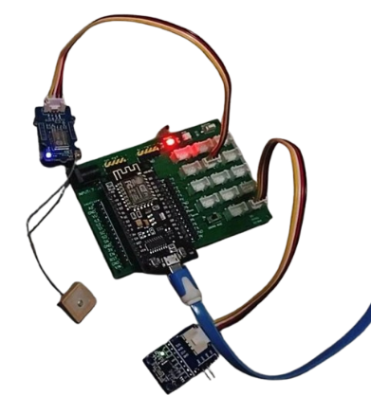

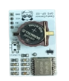
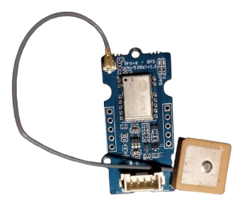
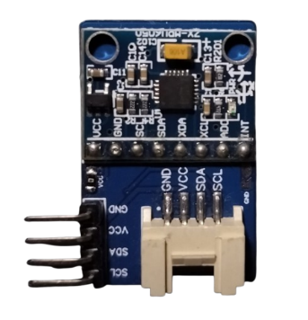

Slide 8
Software Tools Used
Programming & Cloud Tools:
Arduino IDE → Programming NodeMCU.
Google Sheets API → Storing & retrieving real-time data.
Python (TensorFlow, Pandas, NumPy) → ML Model Training.
Flask → Backend Web Development.
HTML, CSS, JavaScript, Node JS → Web Interface.

Slide 9
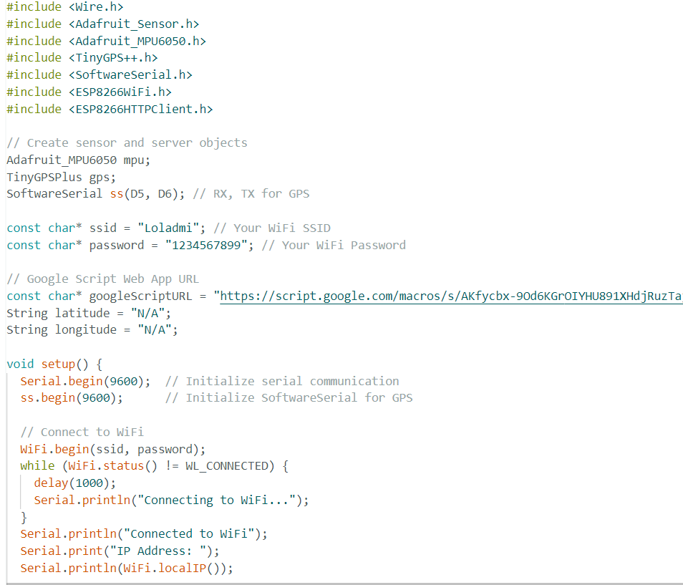
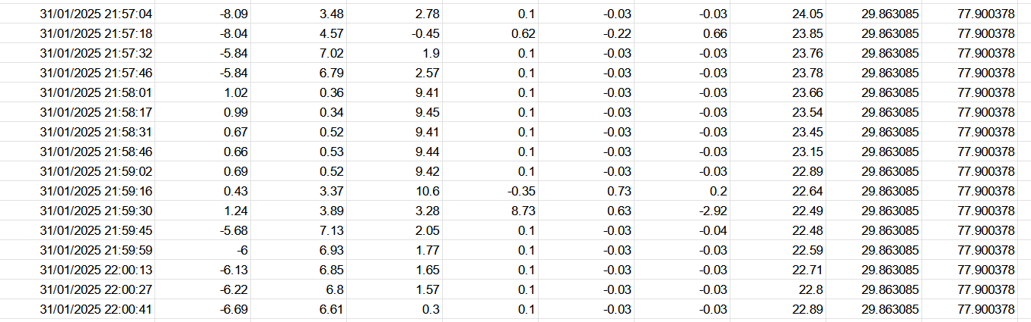
Data Collection & Transmission
How data is collected?
MPU6050 captures movement data → Acceleration & Gyroscope.
GPS collects real-time location.
NodeMCU transmits data to Google Sheets via WiFi.

Slide 10
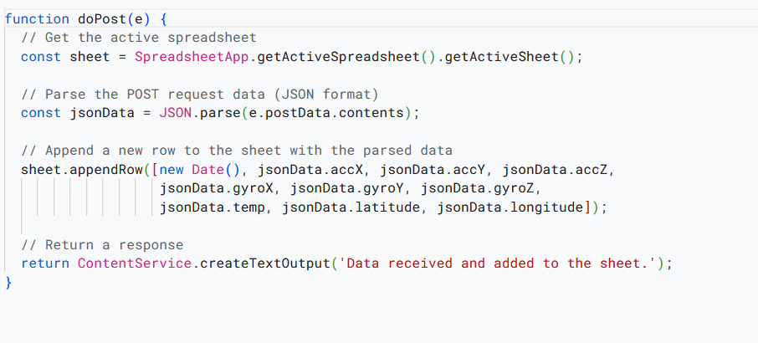
Google Apps Script (Data Handling)
How does Google Sheets receive data?
Google Apps Script receives POST requests.
Parses JSON data and adds it as a new row in the google sheet.

Slide 11
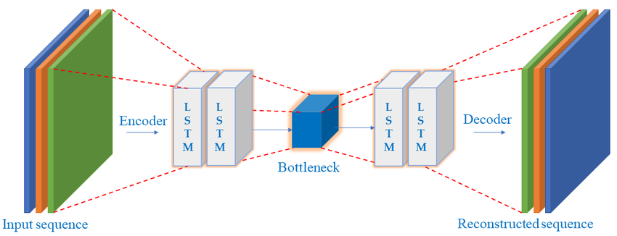
Machine Learning Model (LSTM Autoencoder)
Why LSTM Autoencoder?
Captures time-series anomalies in movement & location data.
Learns normal behavior & detects deviations (anomalies).
Autoencoder reconstructs data → Higher reconstruction error = Anomaly.

Slide 12
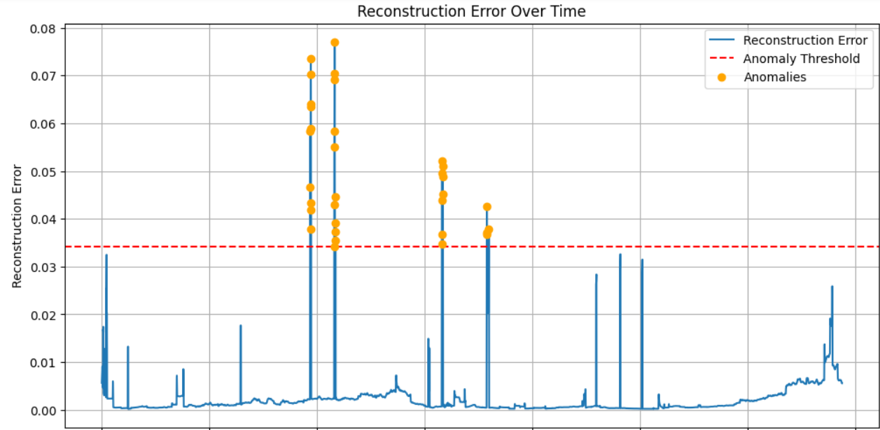
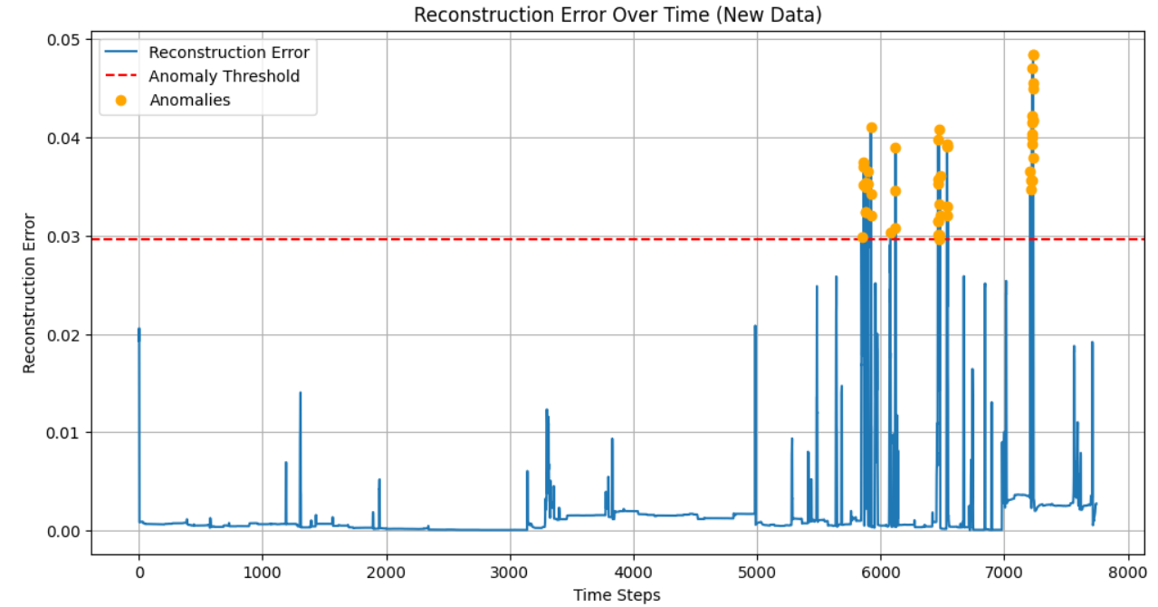
Model Training & Anomaly Detection
Steps for Anomaly Detection:
Train model on normal movement data.
Compute reconstruction error.
Set a dynamic threshold.
Flag anomalies where error > threshold.

Slide 13
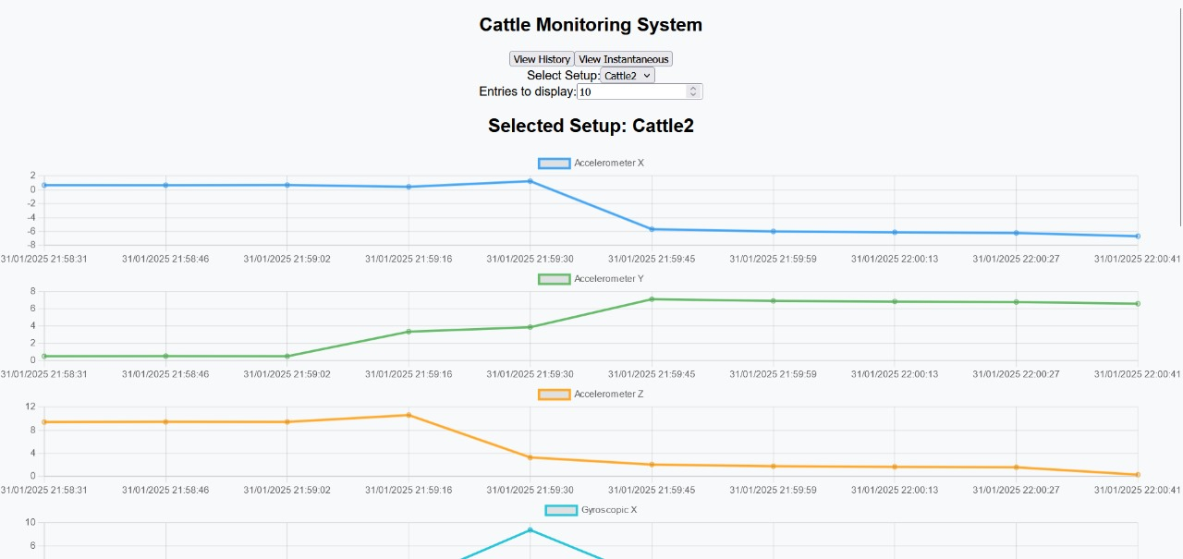
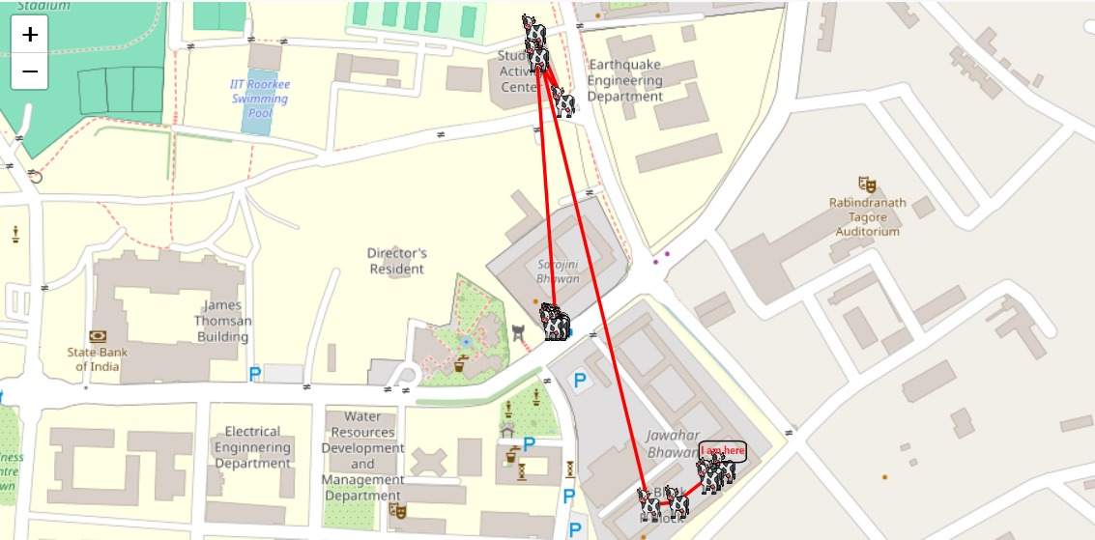
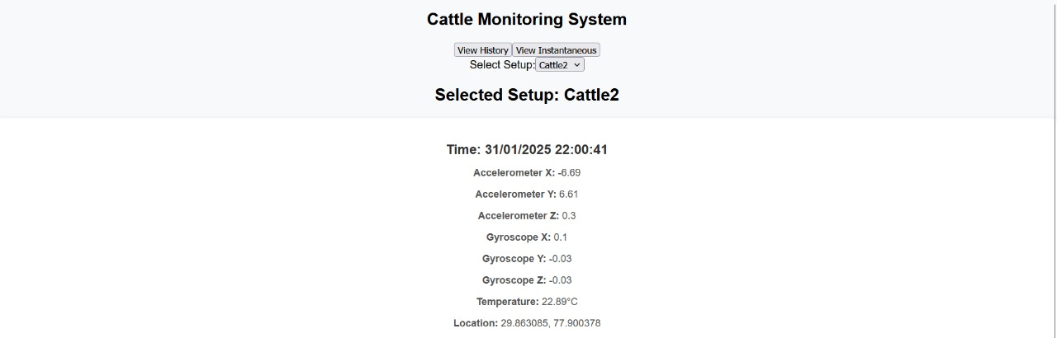
Web Interface for Real-Time Monitoring
How users access live data?
Web App (Built with Flask API & HTML/CSS).
Shows sensor readings, anomalies & alerts.
Mobile-friendly dashboard.

Slide 14
Future Enhancements
Possible Improvements 🔹 Solar-powered GPS trackers to extend battery life. 🔹 AI-based predictive analytics for disease detection. 🔹 Integration with SMS/Email alerts for instant farmer notifications. 🔹 Mobile App with voice alerts & analytics dashboard.

Slide 15
Conclusion
Summary of Achievements
Developed a real-time livestock monitoring system.
Successfully implemented IoT, ML, and cloud-based processing.
Achieved high anomaly detection accuracy.
Deployed a web-based dashboard for monitoring.

Slide 16
Links
GitHub: https://github.com/bshah123/LivestockMontiroingSystem
Model Code: https://tinyurl.com/LSTM-Model-Code
Arduino code : https://tinyurl.com/Arduino-C
Link to Database: https://tinyurl.com/LMS-Sensor
Youtube Video: https://www.youtube.com/watch?v=DYKId9N2SVI

Slide 17
THANK YOU !

